Slide 1
Learning ASP.Net Core MVC

Slide 2
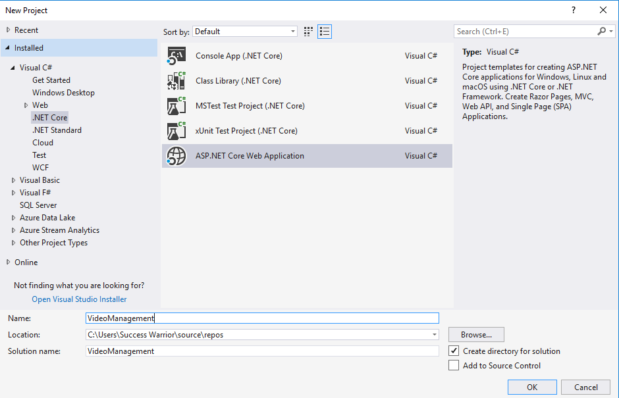

Slide 3
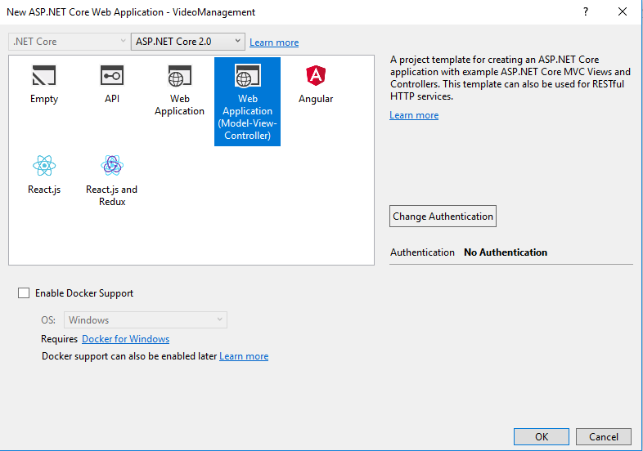

Slide 4
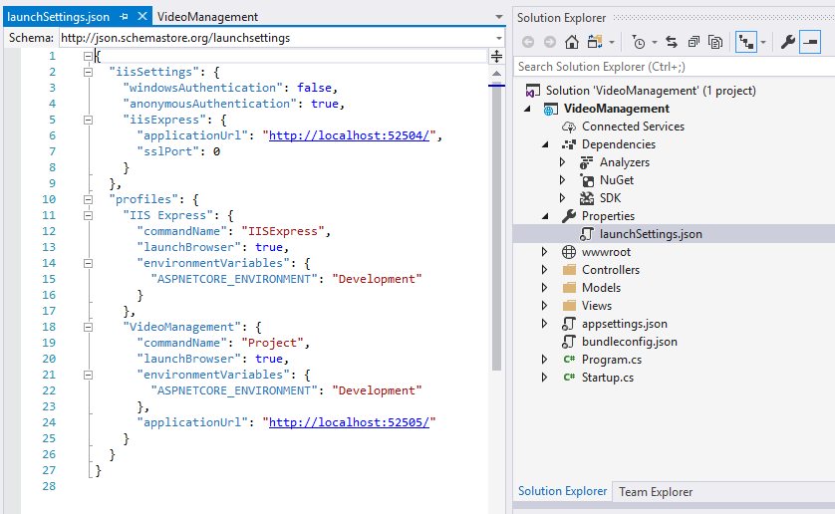

Slide 5
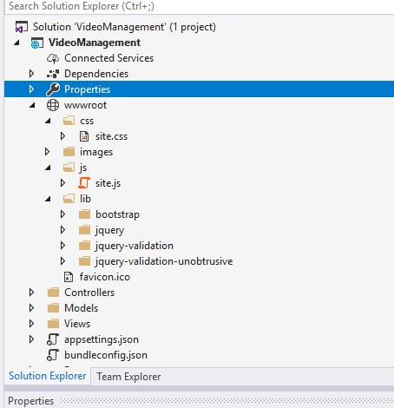

Slide 6
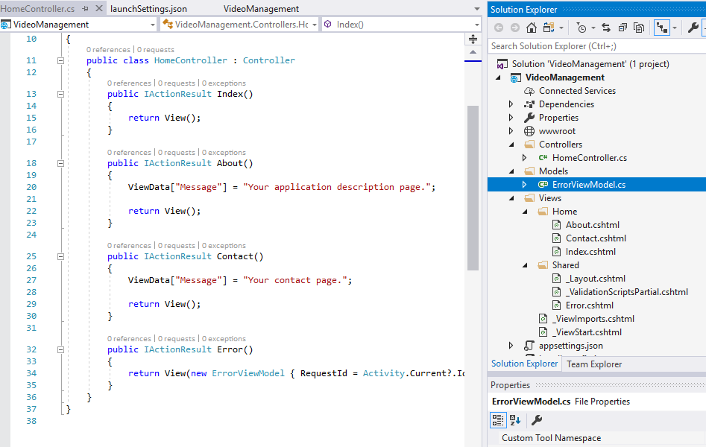

Slide 7
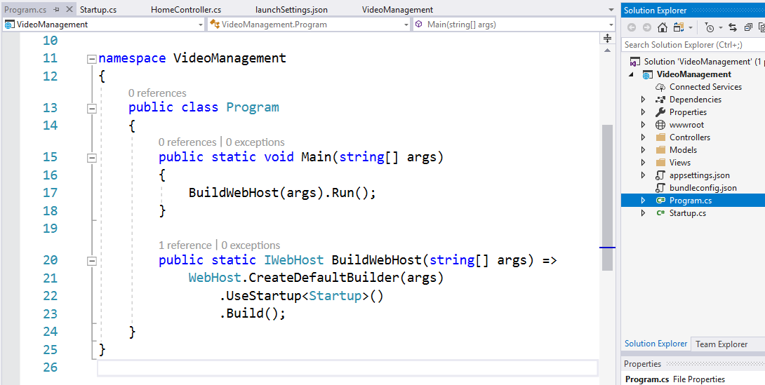

Slide 8
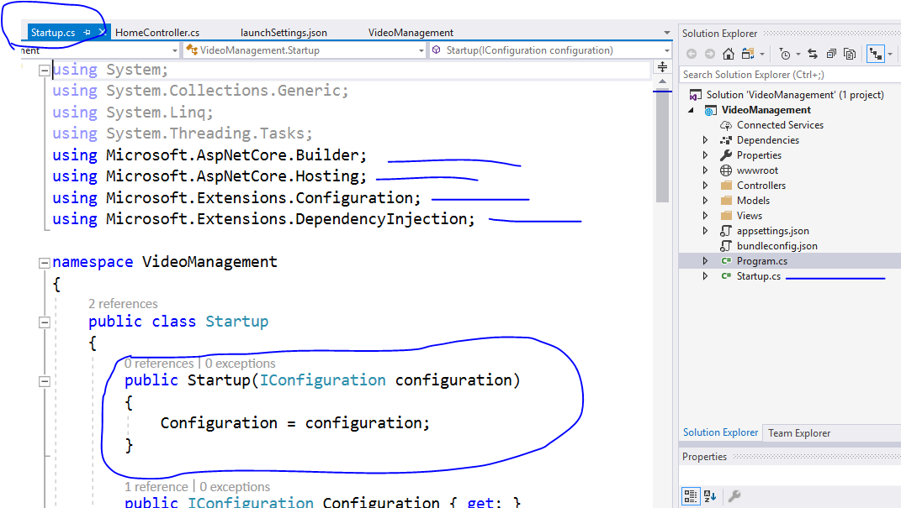
We always have DI implemented in core projects

Slide 9
Dependency injection (services)
A service is a component that's intended for common consumption in an app. Services are made available through dependency injection (DI).
ASP.NET Core includes a native Inversion of Control (IoC) container that supports constructor injection by default. You can replace the default native container if you wish. In addition to its loose coupling benefit, DI makes services available throughout your app.
ASP.NET Core includes a simple built-in container (represented by the IServiceCollection interface) that supports constructor injection by default, and ASP.NET makes certain services available through DI.

Slide 10
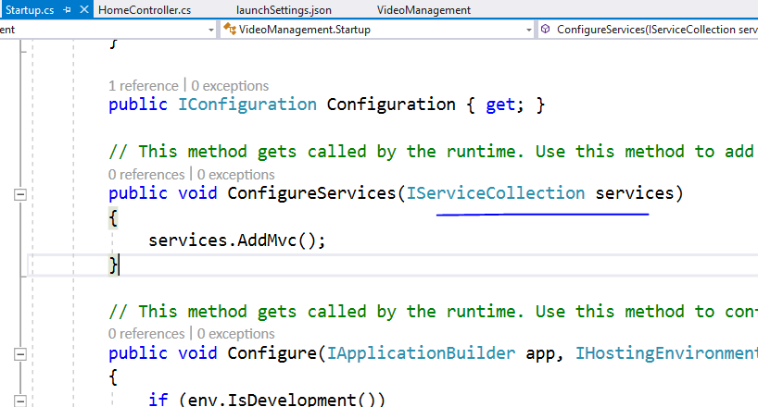

Slide 11
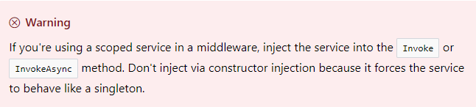
Service lifetimes and registration options
ASP.NET services can be configured with the following lifetimes:
Transient [something like percall]
Transient lifetime services are created each time they're requested. This lifetime works best for lightweight, stateless services.
Scoped [something like persession]
Scoped lifetime services are created once per request.

Slide 12
Singleton
Singleton lifetime services are created the first time they're requested (or when ConfigureServices is run if you specify an instance there) and then every subsequent request will use the same instance.
If your application requires singleton behavior, allowing the services container to manage the service's lifetime is recommended instead of implementing the singleton design pattern and managing your object's lifetime in the class yourself.

Slide 13
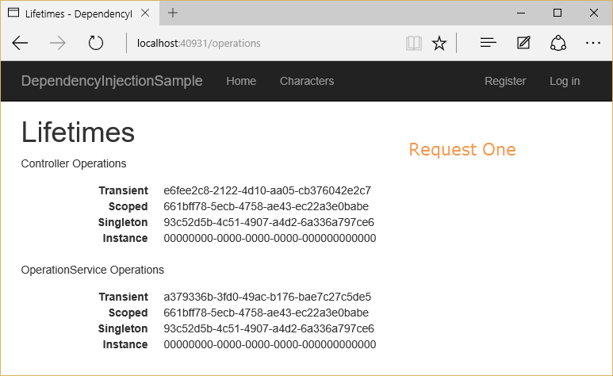
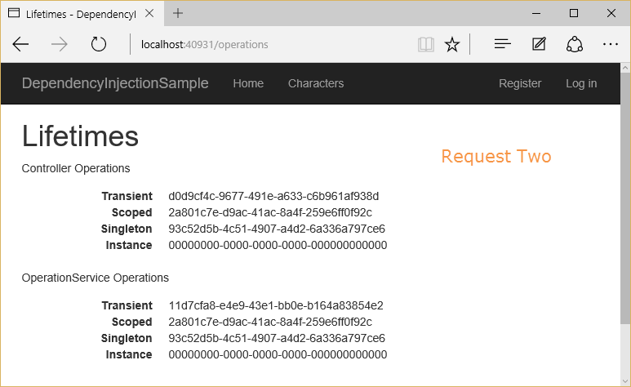

Slide 14
ASP.NET Core Middleware
What is middleware?
Middleware is software that's assembled into an application pipeline to handle requests and responses.
Each component:
Chooses whether to pass the request to the next component in the pipeline.
Can perform work before and after the next component in the pipeline is invoked.
[works on a concepts of chaining]
Request delegates are used to build the request pipeline. The request delegates handle each HTTP request.
Each middleware component in the request pipeline is responsible for invoking the next component in the pipeline, or short-circuiting the chain if appropriate.

Slide 15
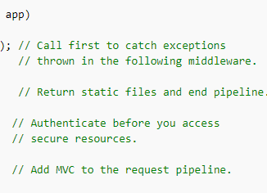
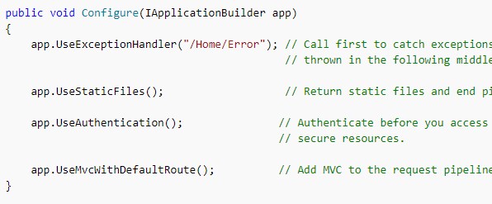
Ordering
The order that middleware components are added in the Configure method defines the order in which they're invoked on requests, and the reverse order for the response. This ordering is critical for security, performance, and functionality.

Slide 16
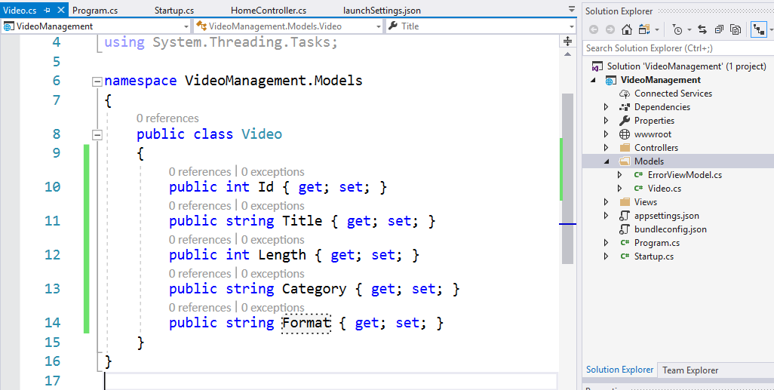

Slide 17
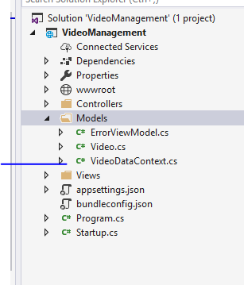

Slide 18
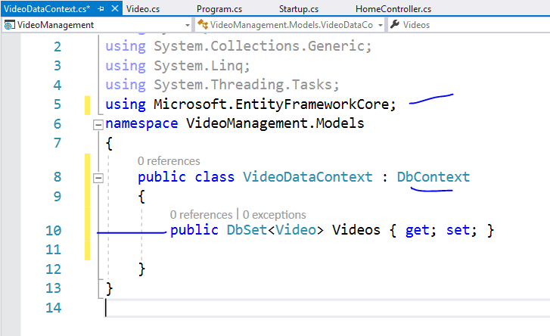

Slide 19
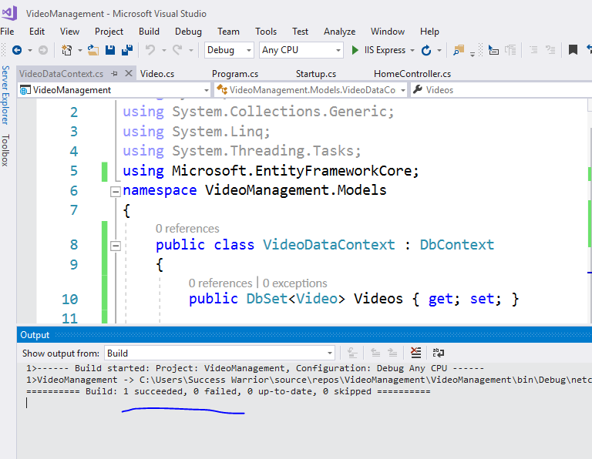

Slide 20
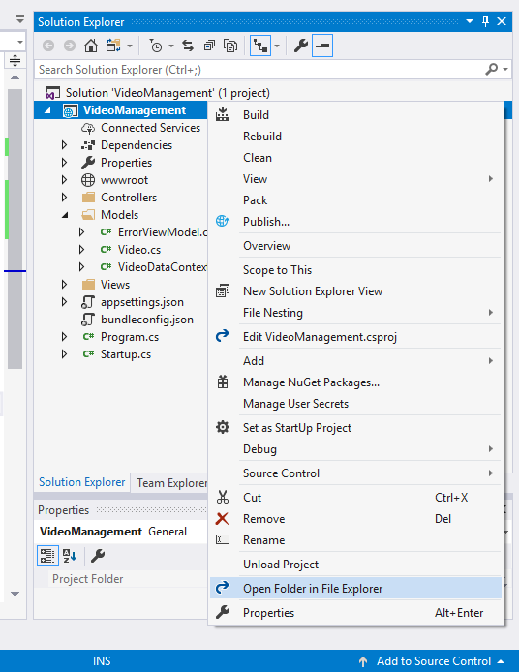

Slide 21
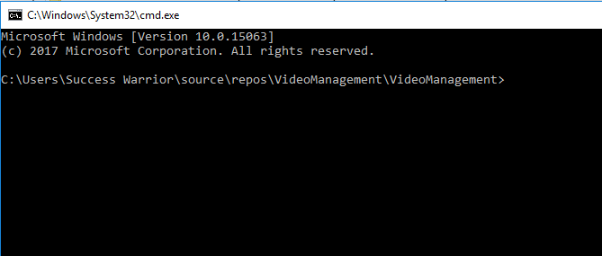

Slide 22
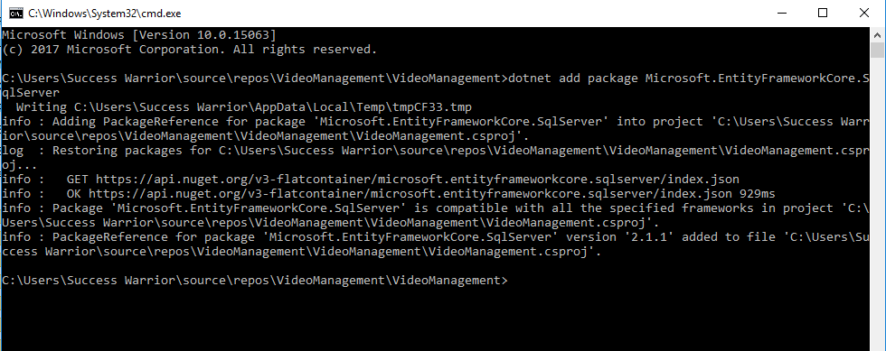
dotnet add package Microsoft.EntityFrameworkCore.SqlServer

Slide 23
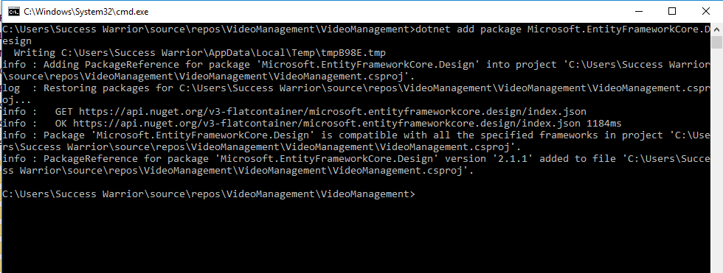
dotnet add package Microsoft.EntityFrameworkCore.Design

Slide 24
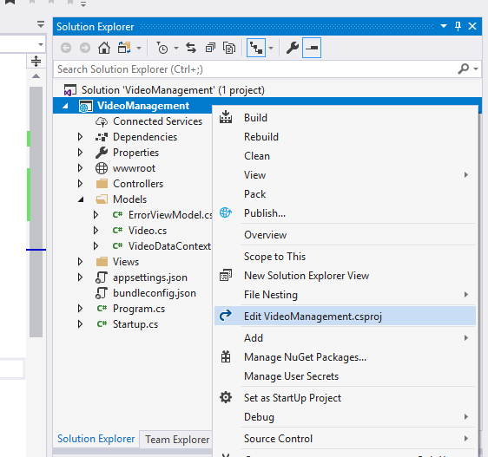

Slide 25
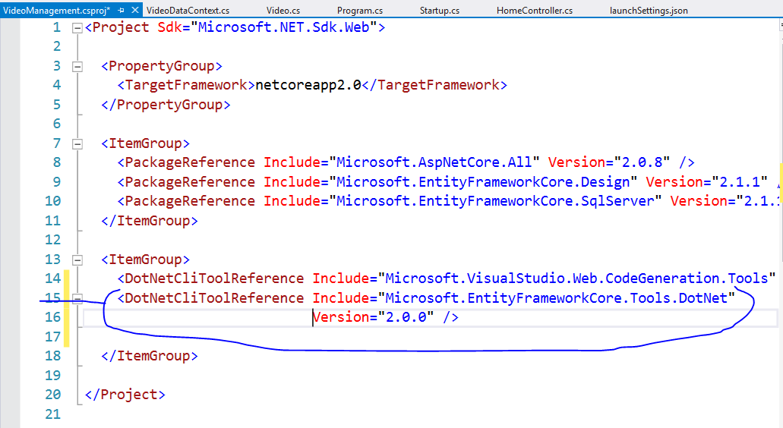
Add this one line and save

Slide 26
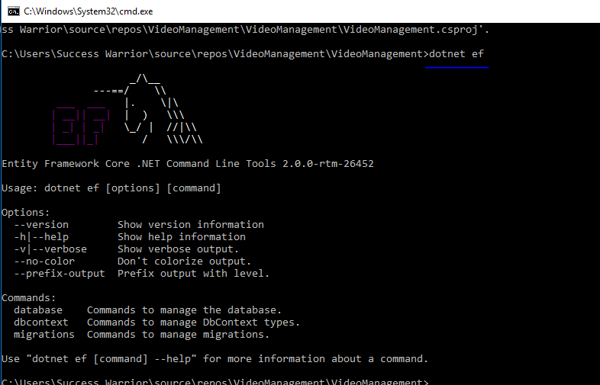
dotnet ef

Slide 27
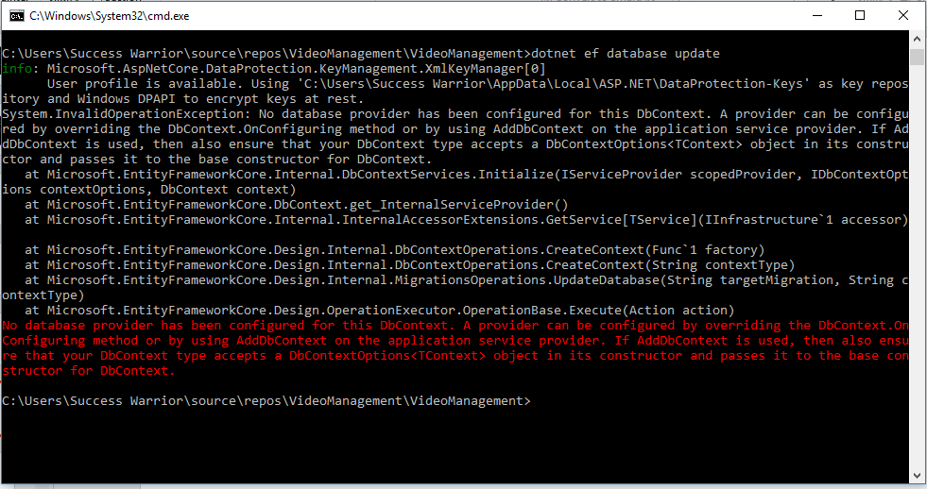
dotnet ef database update

Slide 28
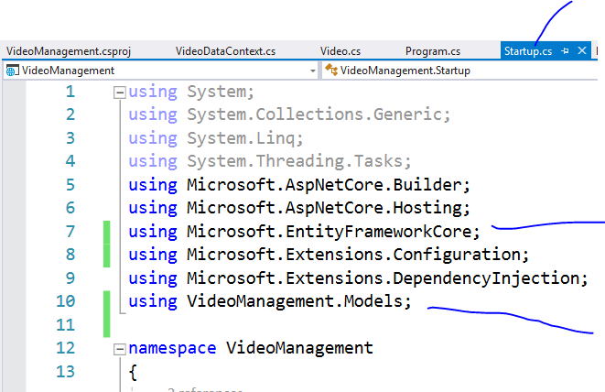

Slide 29
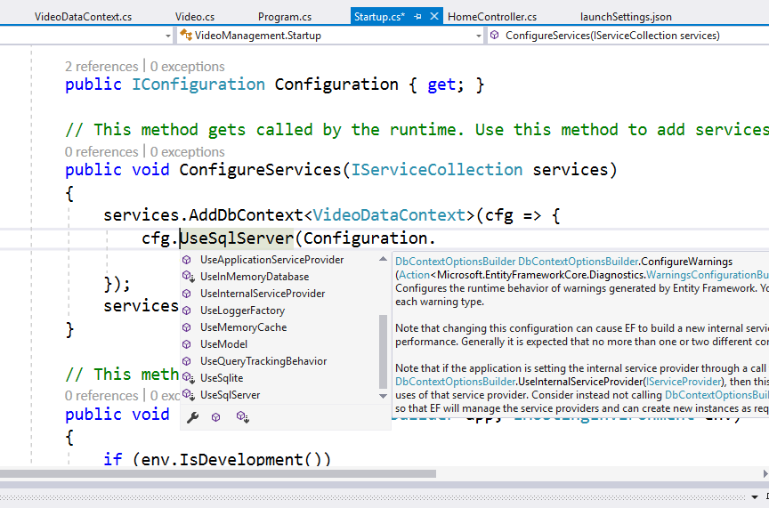

Slide 30
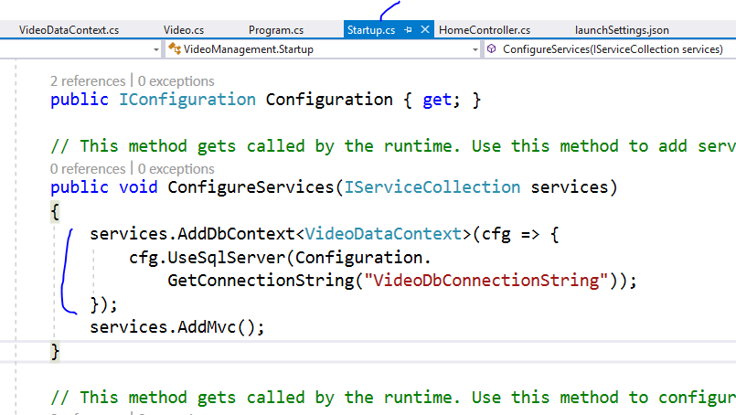

Slide 31
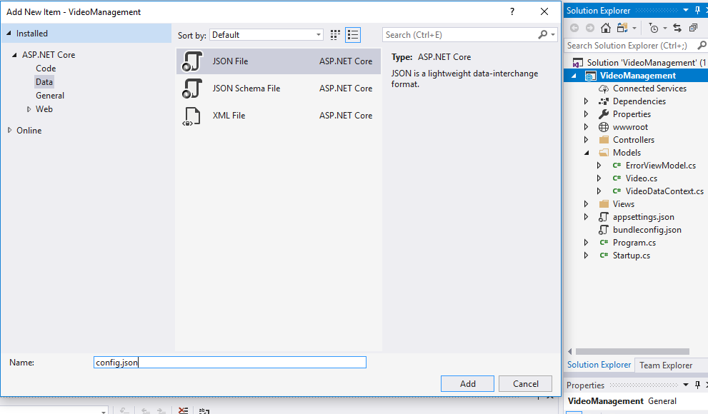
Now add new json file like this

Slide 32
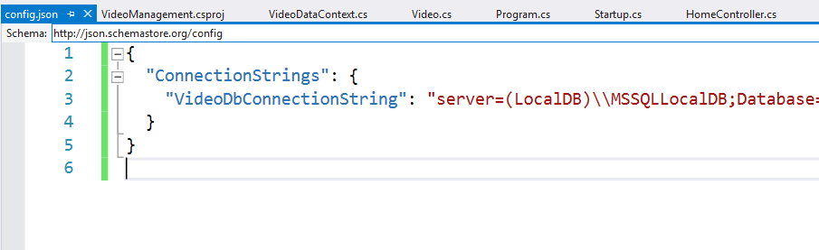
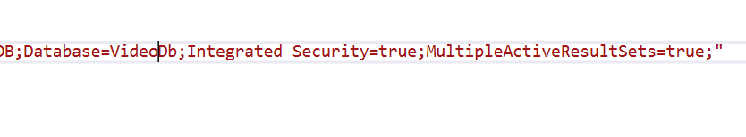

Slide 33
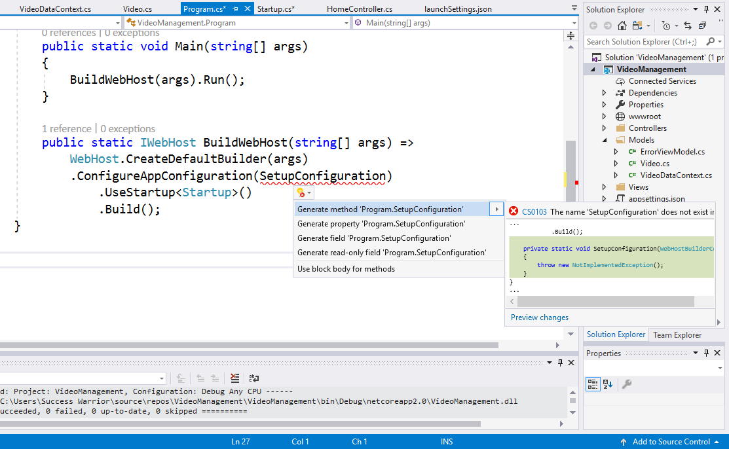
Add this code

Slide 34
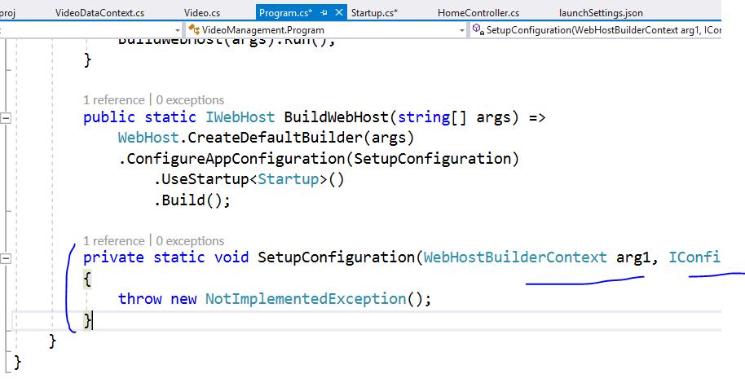
You will get like this

Slide 35
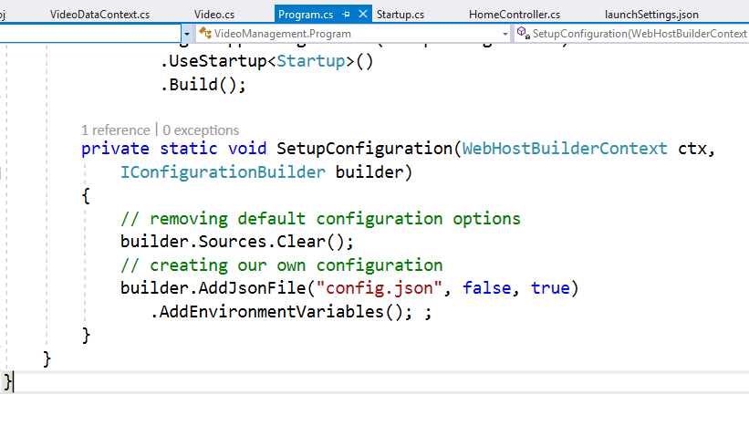
Changing parameters name and adding logic

Slide 36
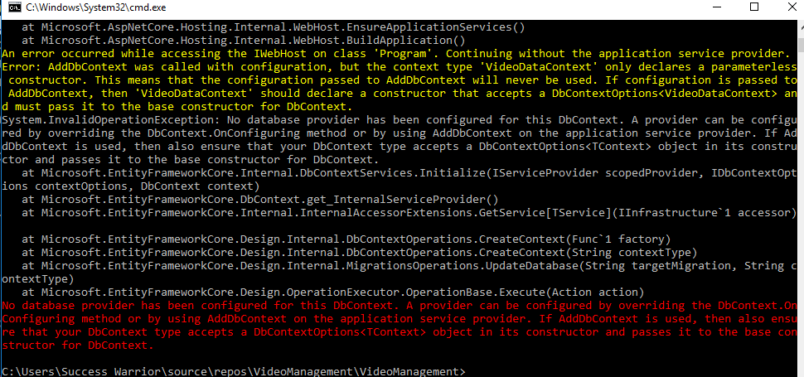
Now if you run same command you will get like this
dotnet ef database update

Slide 37
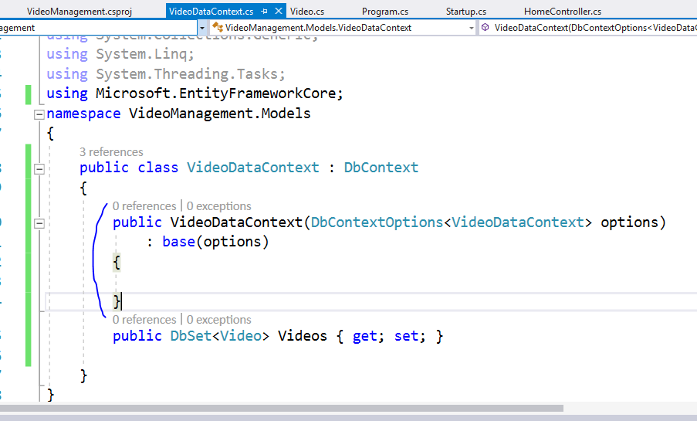

Slide 38
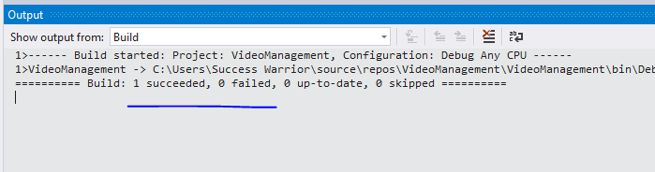

Slide 39
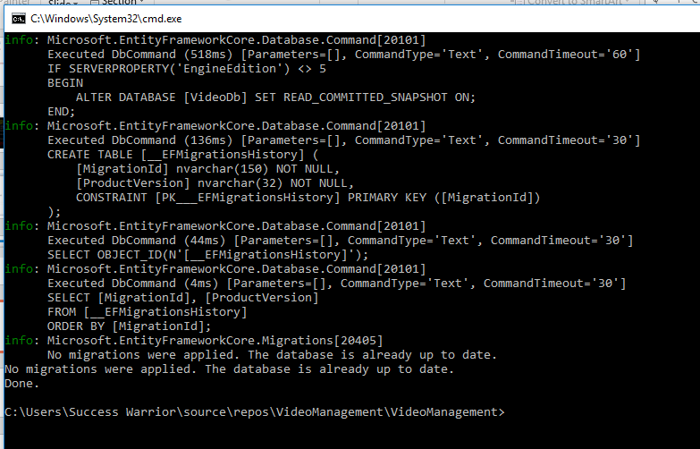
dotnet ef database update

Slide 40
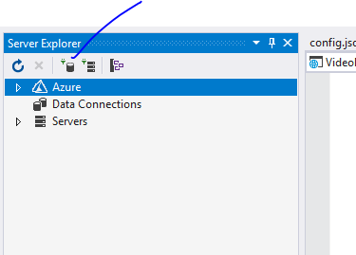
Now we should
Get database

Slide 41
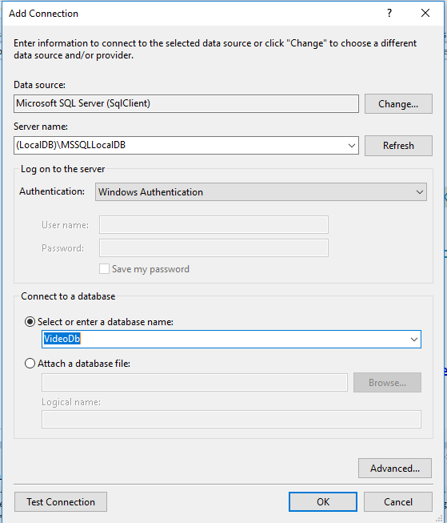

Slide 42
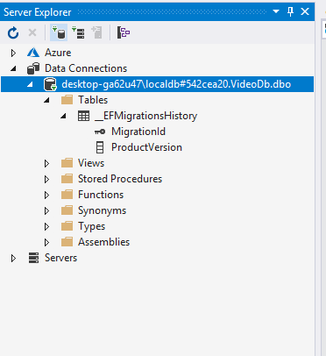
We got db
BUT
Where is our Table?

Slide 43
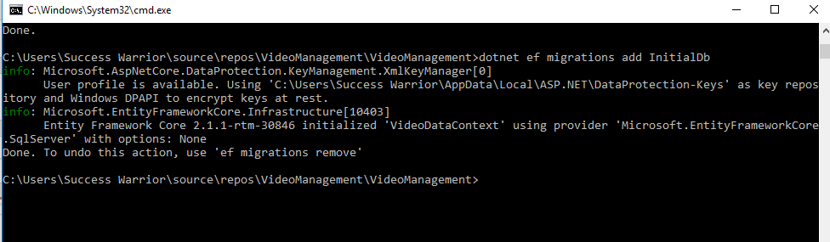
To get tables you have do migrations using this
dotnet ef migrations add InitialDb
Where InitialDb is just a name of migration

Slide 44
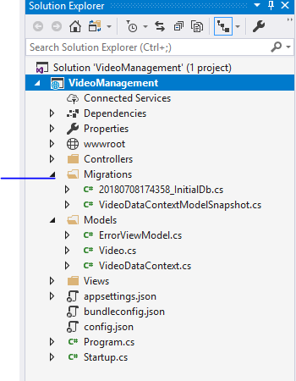
This will give us first migration
Context with our own table structure
But still we are not getting table in datbase

Slide 45
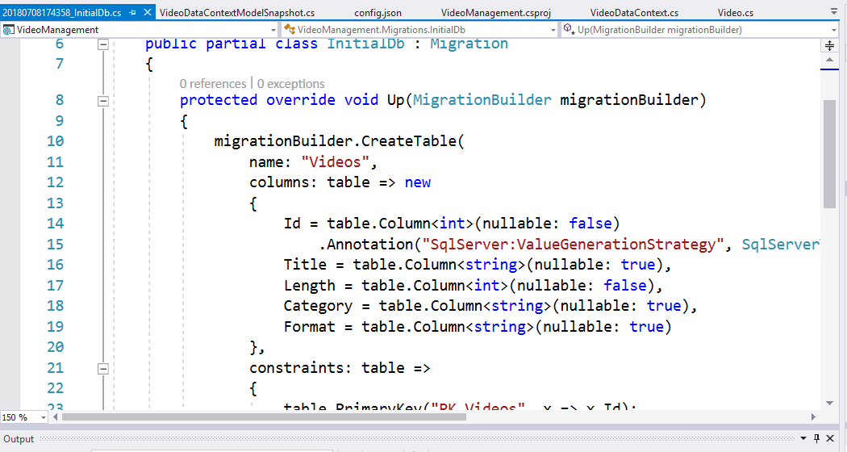

Slide 46
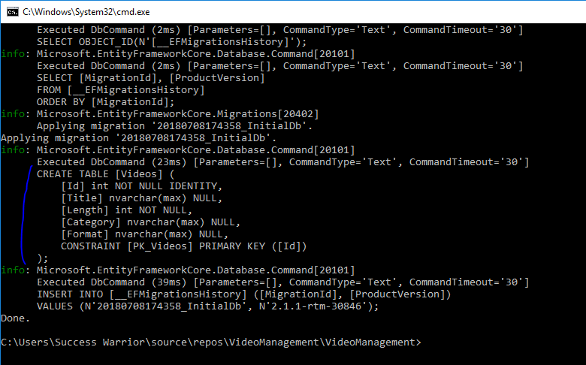
Now last time fire this command
dotnet ef database update

Slide 47
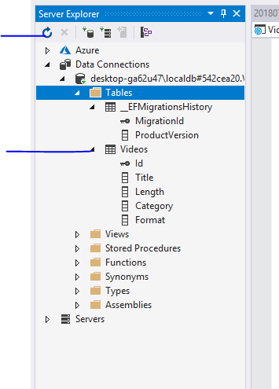

Slide 48
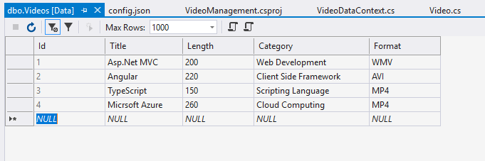
Lets add some dummy records in table

Slide 49
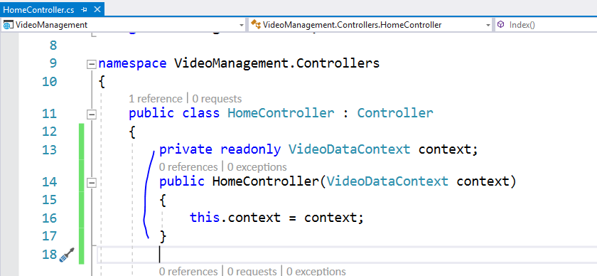

Slide 50
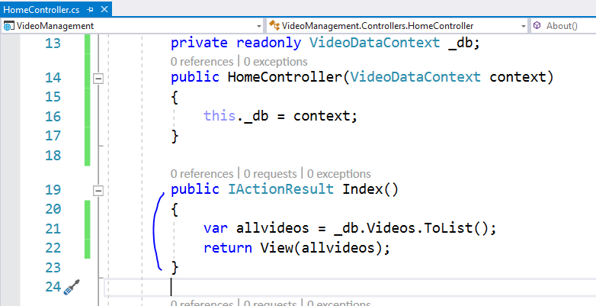

Slide 51
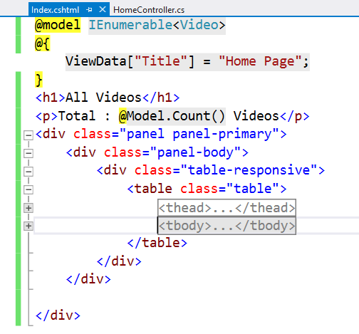

Slide 52


Slide 53


Slide 54


Slide 55


Slide 56


Slide 57


Slide 58


Slide 59


Slide 60


Slide 61


Slide 62


Slide 63

We already have this in layout page

Slide 64


Slide 65


Slide 66


Slide 67


Slide 68



Slide 69


Slide 70
Now let’s implement repository pattern for this

Slide 71


Slide 72


Slide 73


Slide 74

This interface will help us in mocking while testing code and in services also and
when you create generic repository

Slide 75



Slide 76

Add new method and implement it in class

Slide 77


Slide 78


Slide 79
Now let’s use this repository in Web API

Slide 80


Slide 81


Slide 82


Slide 83


Slide 84


Slide 85


Slide 86
Check same in postman too

Slide 87


Slide 88


Slide 89



Slide 90


Slide 92

Now lets try POST with API

Slide 93


Slide 94


Slide 95


Slide 96


Slide 97


Slide 98


Slide 99


Slide 100


Slide 101
Now use this sample in IdentityServer4 topic

